Slide 1
Financing Sports Facilities
Chapter 16

Slide 2
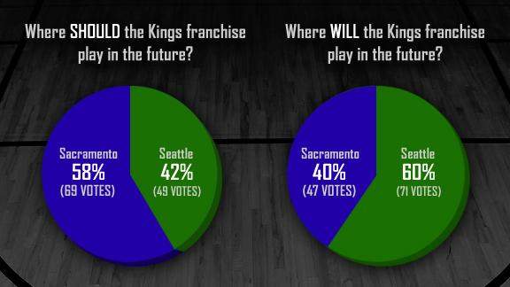
Lesson Direction
Scarcity
Rationing
Competition

Slide 3
Lesson: Financing Sports Facilities
Objectives:
Explore the principles of investment decisions
Examine the cases for public subsidies of privately owned facilities
Analyze ways in which governments can raise funds for sports facilities

Slide 4
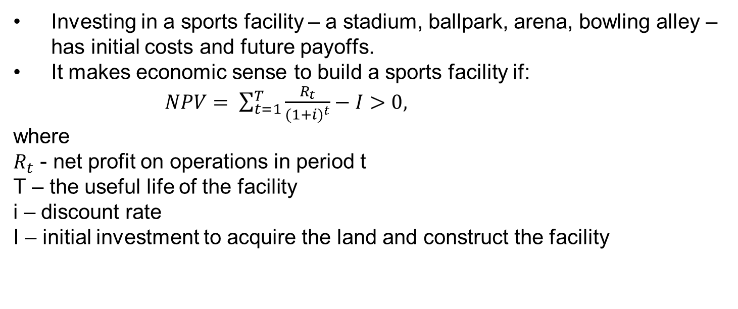
Investing in a Sports Facility
Investing in a sports facility – a stadium, ballpark, arena, bowling alley – has initial costs and future payoffs.
It makes economic sense to build a sports facility if:
$NPV= \sum_{t=1}^{T}{\frac{R_{t}}{{(1+i)}^{t}}−I>0,}$
where
$R_{t}$ - net profit on operations in period t
T – the useful life of the facility
i – discount rate
I – initial investment to acquire the land and construct the facility

Slide 5
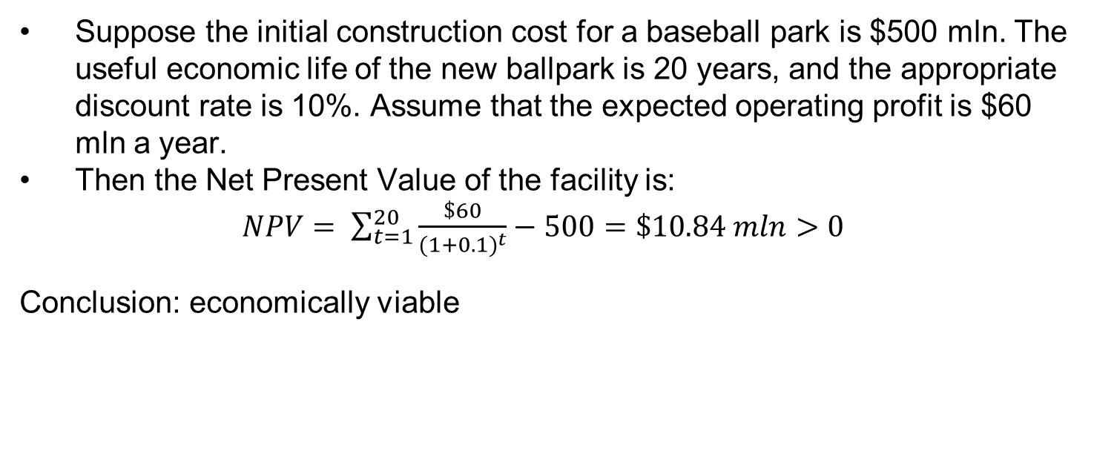
Investing in a Facility: Numerical Example
Suppose the initial construction cost for a baseball park is $500 mln. The useful economic life of the new ballpark is 20 years, and the appropriate discount rate is 10%. Assume that the expected operating profit is $60 mln a year.
Then the Net Present Value of the facility is:
$NPV= \sum_{t=1}^{20}{\frac{\$60}{{(1+0.1)}^{t}}−500=\$10.84 mln>0}$
Conclusion: economically viable

Slide 6
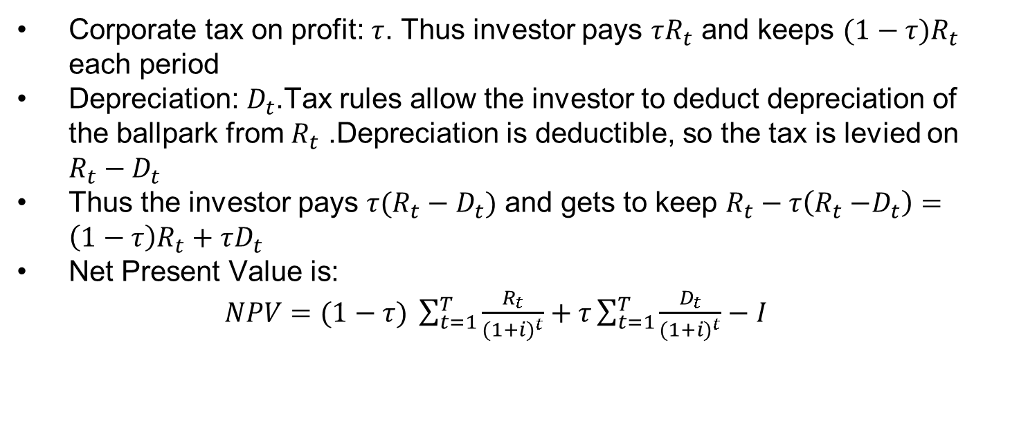
Investing in a Facility: Let’s add taxes
Corporate tax on profit: $τ$. Thus investor pays $τR_{t}$ and keeps $(1−τ)R_{t}$ each period
Depreciation: $D_{t}$.Tax rules allow the investor to deduct depreciation of the ballpark from $R_{t}$ .Depreciation is deductible, so the tax is levied on $R_{t}−D_{t}$
Thus the investor pays $τ(R_{t}−D_{t})$ and gets to keep $R_{t}−τ\left(R_{t}{−D}_{t}\right)=\left(1−τ\right)R_{t}+τD_{t}$
Net Present Value is:
$NPV=(1−τ) \sum_{t=1}^{T}{\frac{R_{t}}{{(1+i)}^{t}}+τ\sum_{t=1}^{T}{\frac{D_{t}}{{(1+i)}^{t}}−I}}$

Slide 7
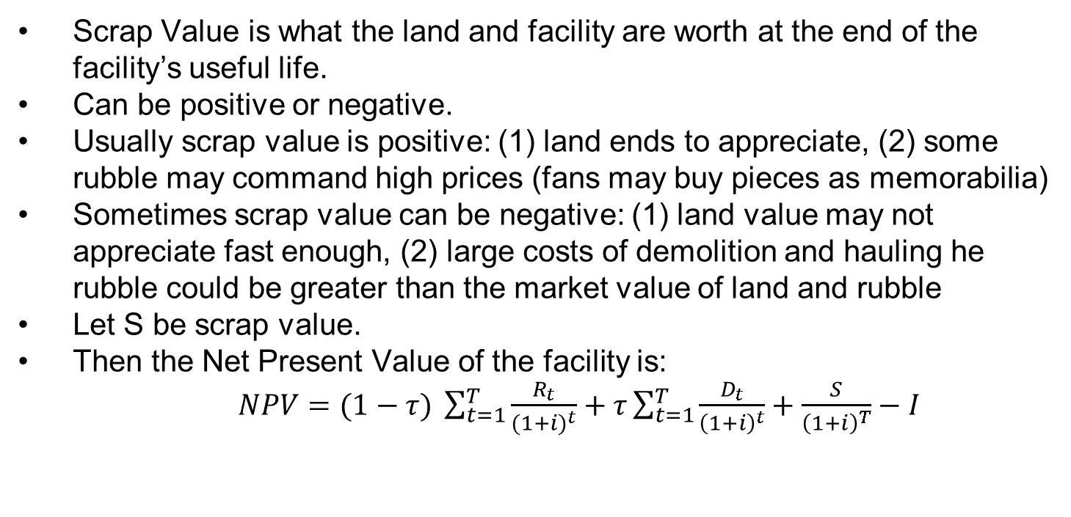
Investing in a Facility: Let’s add Scrap Value
Scrap Value is what the land and facility are worth at the end of the facility’s useful life.
Can be positive or negative.
Usually scrap value is positive: (1) land ends to appreciate, (2) some rubble may command high prices (fans may buy pieces as memorabilia)
Sometimes scrap value can be negative: (1) land value may not appreciate fast enough, (2) large costs of demolition and hauling he rubble could be greater than the market value of land and rubble
Let S be scrap value.
Then the Net Present Value of the facility is:
$NPV=(1−τ) \sum_{t=1}^{T}{\frac{R_{t}}{{(1+i)}^{t}}+τ\sum_{t=1}^{T}{\frac{D_{t}}{{\left(1+i\right)}^{t}}+\frac{S}{{\left(1+i\right)}^{T}}−I}}$

Slide 8
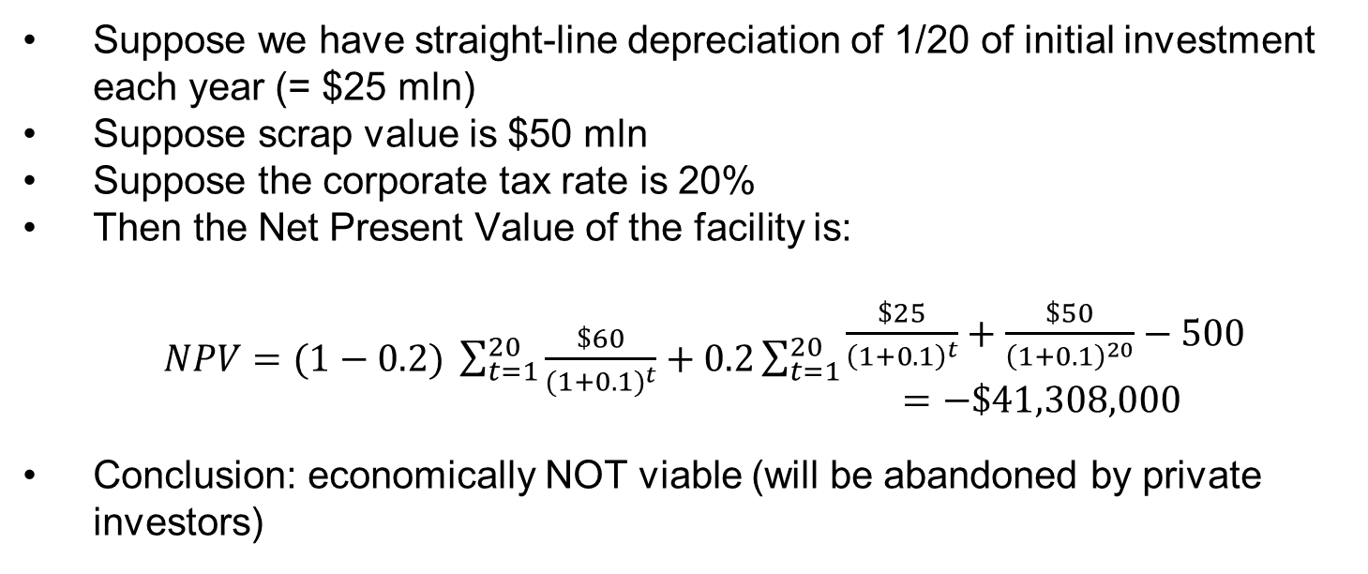
Back to the Numerical Example
Suppose we have straight-line depreciation of 1/20 of initial investment each year (= $25 mln)
Suppose scrap value is $50 mln
Suppose the corporate tax rate is 20%
Then the Net Present Value of the facility is:
$NPV=(1−0.2) \sum_{t=1}^{20}{\frac{\$60}{{(1+0.1)}^{t}}+0.2\sum_{t=1}^{20}{\begin{aligned}\frac{\$25}{{\left(1+0.1\right)}^{t}}+\frac{\$50}{{\left(1+0.1\right)}^{20}}−500 \\ =−\$41,308,000 \end{aligned}}}$
Conclusion: economically NOT viable (will be abandoned by private investors)

Slide 9
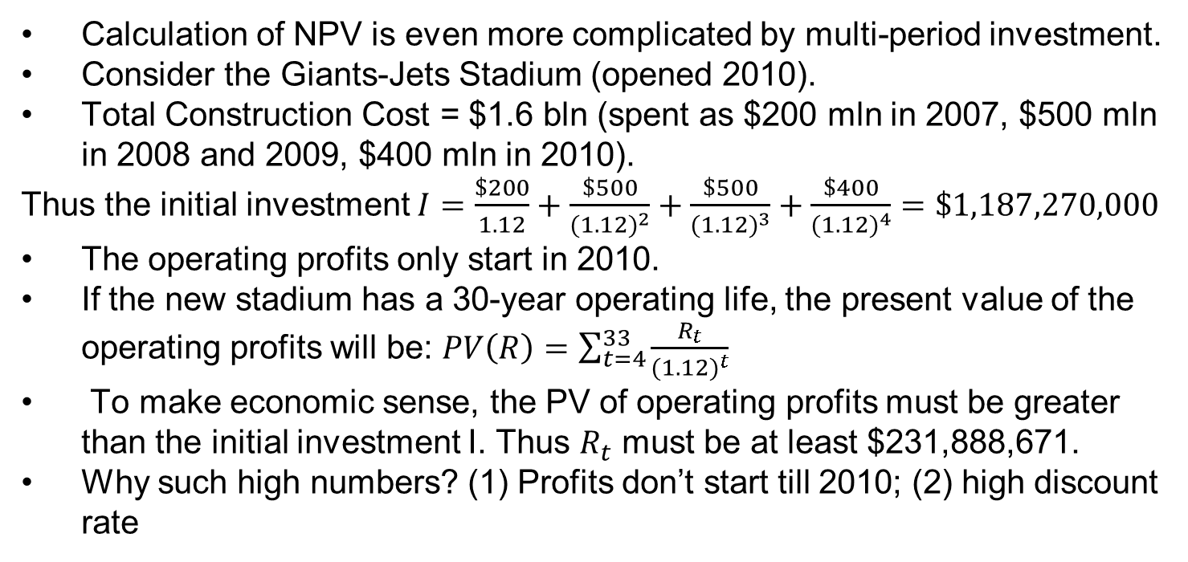
The Giants-Jets Stadium
Calculation of NPV is even more complicated by multi-period investment.
Consider the Giants-Jets Stadium (opened 2010).
Total Construction Cost = $1.6 bln (spent as $200 mln in 2007, $500 mln in 2008 and 2009, $400 mln in 2010).
Thus the initial investment $I=\frac{\$200}{1.12}+\frac{\$500}{{(1.12)}^{2}}+\frac{\$500}{{(1.12)}^{3}}+\frac{\$400}{{(1.12)}^{4}}=\$1,187,270,000$
The operating profits only start in 2010.
If the new stadium has a 30-year operating life, the present value of the operating profits will be: $PV\left(R\right)=\sum_{t=4}^{33}{\frac{R_{t}}{{(1.12)}^{t}}}$
To make economic sense, the PV of operating profits must be greater than the initial investment I. Thus $R_{t}$ must be at least $231,888,671.
Why such high numbers? (1) Profits don’t start till 2010; (2) high discount rate

Slide 10
Private and Public Financing
In the past, facilities were funded by the clubs that used them ( privately owned and privately funded)
Cities began to offer support for stadium construction
To keep their team
To attract a team
Currently, there is a mixture of private and public funding
What does the private-public split depend on?
City’s willingness to pay (e.g. the Nationals Park)
Club’s willingness to move if the city does not pay

Slide 11
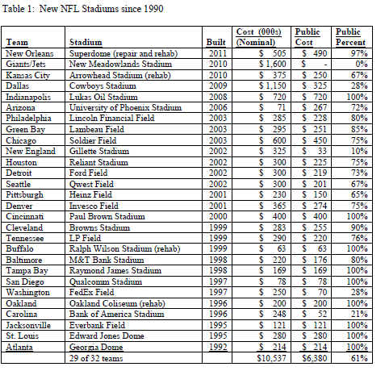
Private and Public Financing: NFL
Source; Baade, R. A., & Matheson, V. A. (2011). Financing professional sports facilities.

Slide 12
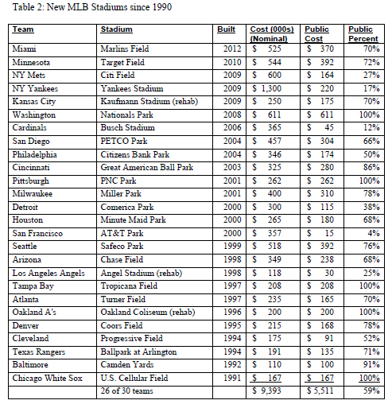
Private and Public Financing: MLB
Source; Baade, R. A., & Matheson, V. A. (2011). Financing professional sports facilities.

Slide 13
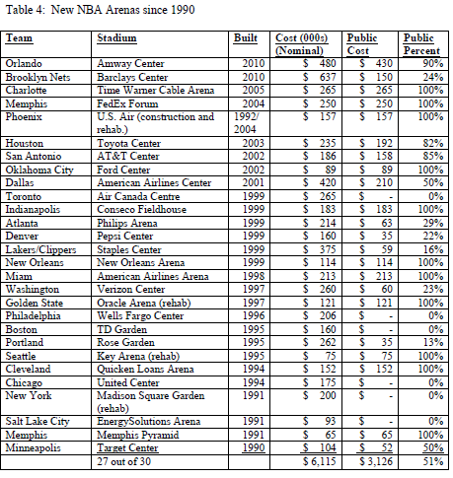
Private and Public Financing: NBA
Source; Baade, R. A., & Matheson, V. A. (2011). Financing professional sports facilities.

Slide 14
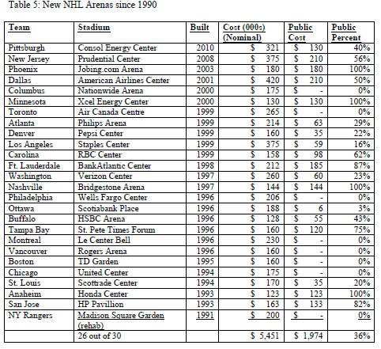
Private and Public Financing: NHL
Source; Baade, R. A., & Matheson, V. A. (2011). Financing professional sports facilities.

Slide 15
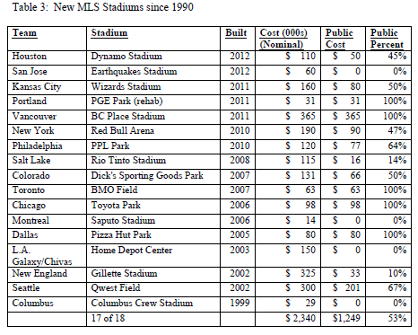
Private and Public Financing: MLS
Source; Baade, R. A., & Matheson, V. A. (2011). Financing professional sports facilities.

Slide 16
Example: Nationals Park
Washington D.C. used to have the Washington Senators. After a bad record, the team moved to Minnesota and changed their name to Twins
D.C. was left without a team
D.C. wanted to get the Montreal Expos who were in a financial crisis.
2005: Montreal Expos become the Washington Nationals. They shared the RFK Stadium with D.C. United (MLS team) during 3 seasons.
2008: They get The Nationals Park: cost $611 mln, financed by D.C. entirely

Slide 17
Example: Nationals Park
How did D.C. finance their investment?
Sold 30-year municipal bonds to cover the cost of the land + ballpark
To cover the interest on the bonds, the city found 3 revenue sources:
Rent to be paid by the Nationals of $5.5 mln per year
In-stadium taxes on tickets, concessions, merchandise sales of $11-14 mln
Taxes on businesses in the city of $21 - $24 mln
Burden on the team
Burden on the businesses

Slide 18
Stadium Financing in the NFL
Due to revenue sharing and national broadcast revenues – even smaller cities can support an NFL franchise
Result: franchises can easily relocate
if an aggressive city puts together a good stadium deal
Examples:
LA Rams moved to St. Louis, then moved back to LA
Cleveland Browns became the Baltimore Ravens
Houston Oilers became Tennessee Titans
But the league wants to discourage the moves from larger media markets to smaller media markets. Why?
Moving from LA, Cleveland or Houston to Baltimore, Nashville or St. Louis may reduce future broadcast licensing fees, due to a reduction in popularity.

Slide 19
Stadium Financing in the NFL
When the Cleveland Browns left, Cleveland prepared an antitrust lawsuit against the NFL
The NFL…
settled the suit by expanding into Cleveland
Does this mean that the NFL does not control its expansions?
To protect the large markets, the owners created The “G-3” fund: the NFL was going to lend up to 50% of the private share of the cost of a new stadium. This was an interest-free loan that could be repaid over a 15-year period with revenues from personal seat licenses and premium seating in the new stadium.
Not only large markets used the program: also smaller markets did. The “G-3” fund dried up in 2007.

Slide 20
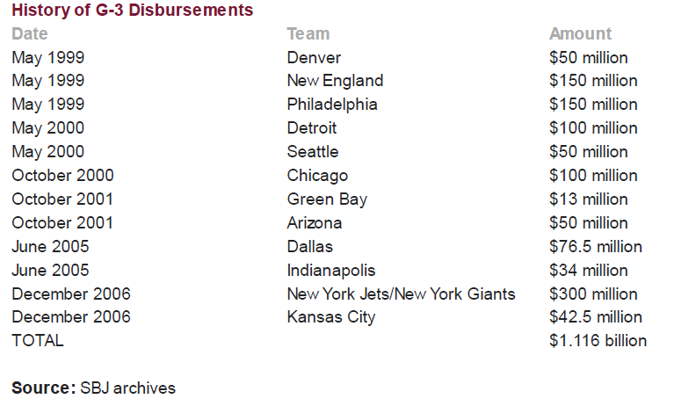
Stadium Financing in the NFL
Source: Daniel Kaplan, “NFL Owners Give $300M for N.Y. Stadium,” Sports Business Journal, Dec 11, 2006, p.3
Notes:
http://www.sportsbusinessdaily.com/Journal/Issues/2006/12/20061211/This-Weeks-News/NFL-Owners-Give-$300M-For-NY-Stadium.aspx

Slide 21
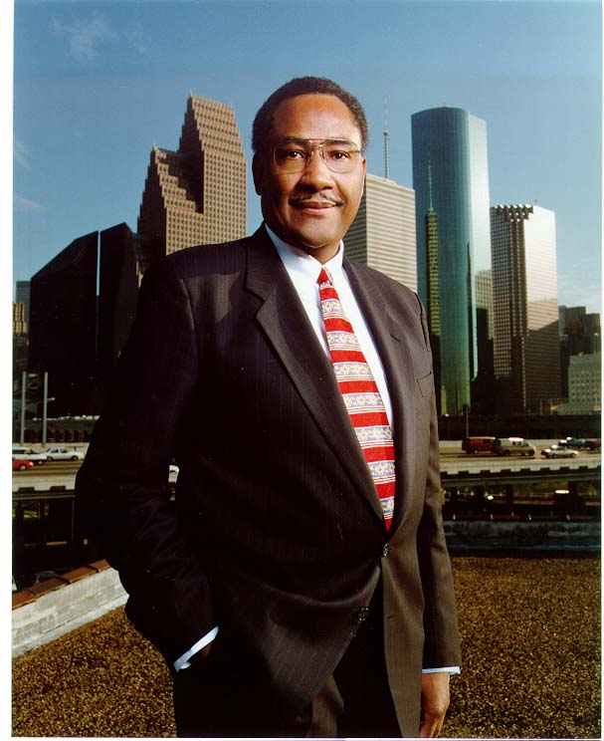
“Having a football team back in Houston will bring thousands of visitors to our city, and it will generate millions of dollars in our city. I’m excited about our new stadium with a retractable roof. And we’re also very happy about getting a Super Bowl, and as you know that’s very important economically to the city. It will generate probably $300 or $400 million into our economy. But more importantly, if focuses attention on a city that people do not know enough about.
--Houston Mayor Lee Brown
(1999)
Public Funding for Sports

Slide 22
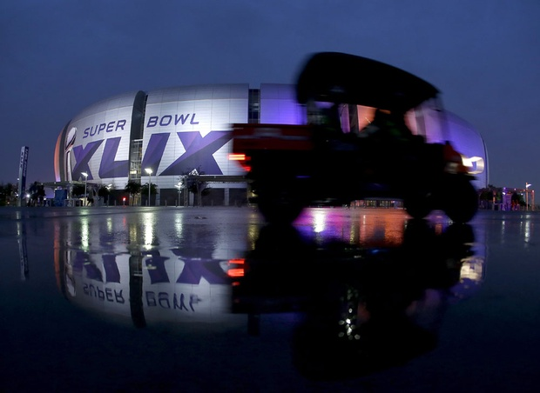
The Burden of Hosting the Super Bowl
More on Hosting
Padding Required: Research on Revenue from Super Bowl
Requirements to Host
Hosting Major Events

Slide 23
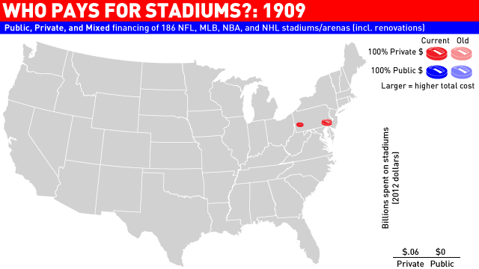
Equity/Political Arguments

Slide 24
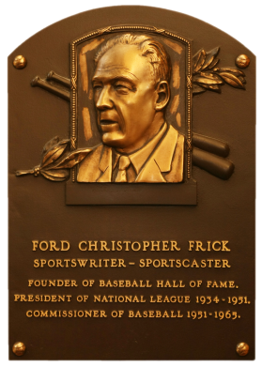
1951 MLB Commissioner Ford Frick announced that cities needed to support teams through publicly owned and maintained stadiums.
This was to be a method for the teams to receive profit from the increased value of businesses around the stadium.
From 2000 to 2006, $9.9 Billion was spent on pro sports facilities. $6.2 Billion (63%) came from public funds.
Why do governments fund stadium construction?

Slide 25
Break up into groups and decide who you think should pay for stadium construction and maintenance.
Prepare 1 or 2 ECONOMIC arguments for why your opinion is valid.
Choose someone to present your ideas.
Who SHOULD pay for stadiums?

Slide 26

We discussed what we thought about whether or not stadiums across the US should be publicly subsidized.
We brought up our own arguments for why this should or should not be the case.
Quick Review from Last Class

Slide 27
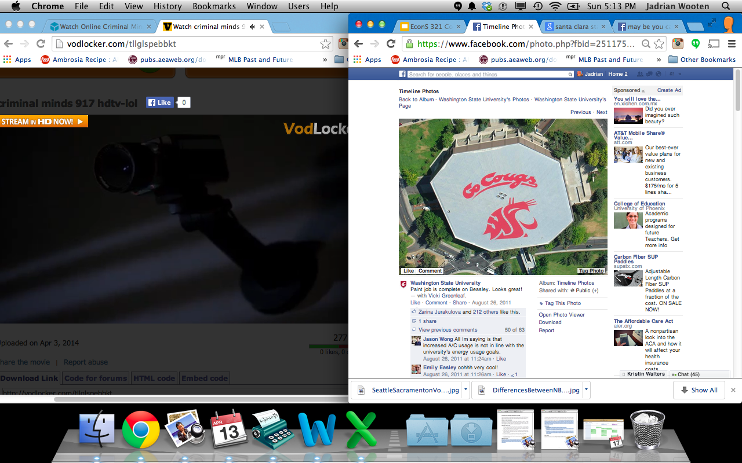
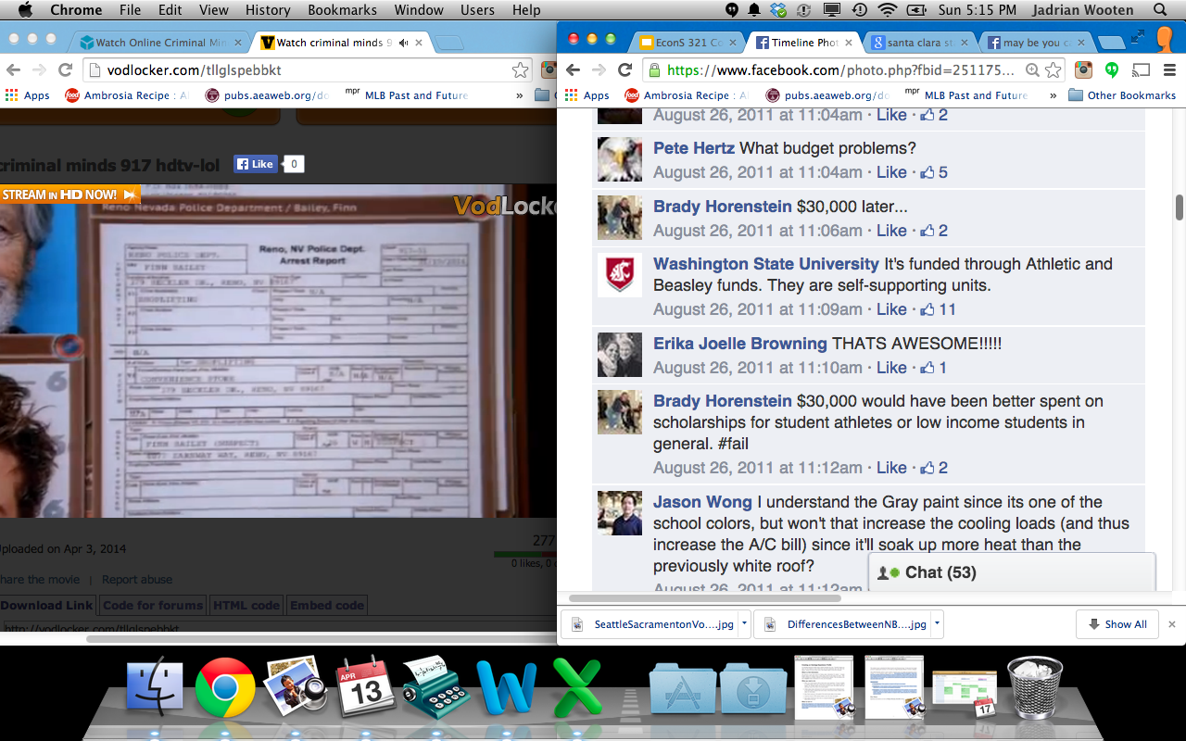
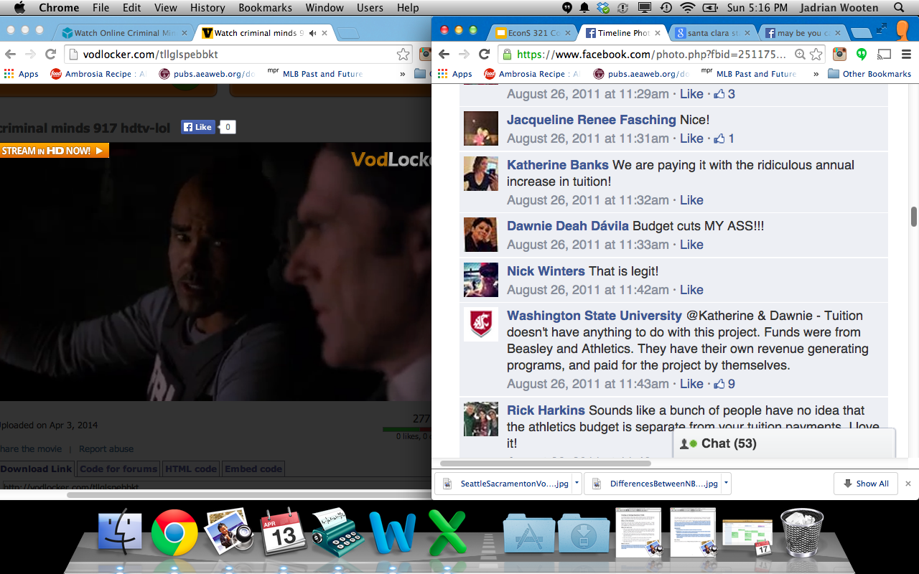
Political/Equity Argument

Slide 28
So what are the arguments typically used?
(-) Better spent elsewhere
(-) It just subsidizes rich people
“Tax the poor to pay the rich”
(+) Needed to keep team competitive
(-) If it’s that important, owners will do it themselves

Slide 29
(-) Better Spent Elsewhere
Would it actually be spent somewhere else?
Would people actually be better off if it was spent somewhere else?

Slide 30
(-) Just Subsidizes Rich People
This gets at the question of “fairness”
Economics does NOT do a good job with making things fair
Everybody sees something different as fair
The world is better off according to economics when total wealth is increased, so we don’t necessarily see a problem here...

Slide 31
(+) Needed to keep team competitive
Would playing in a new stadium increase competitiveness of team?
This depends on if the new stadium increases fans’ demand for quality ON THE FIELD.

Slide 32
(-) If it’s so important, owners will do it
Are owners just trying to get other people to pay for what they would buy anyway? (College scholarships, anyone?)
Other times, a lack of subsidy may in fact hurt society, even if the money is being given to rich people

Slide 33
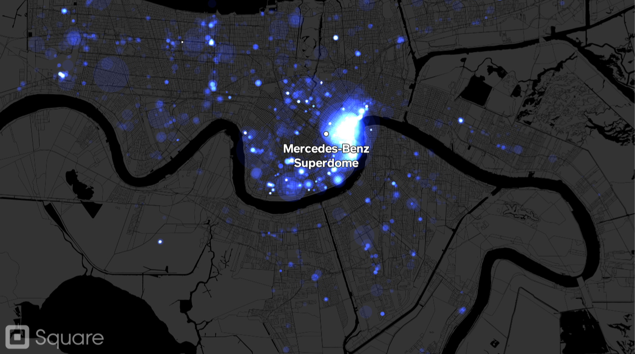
Link to Article

Slide 34
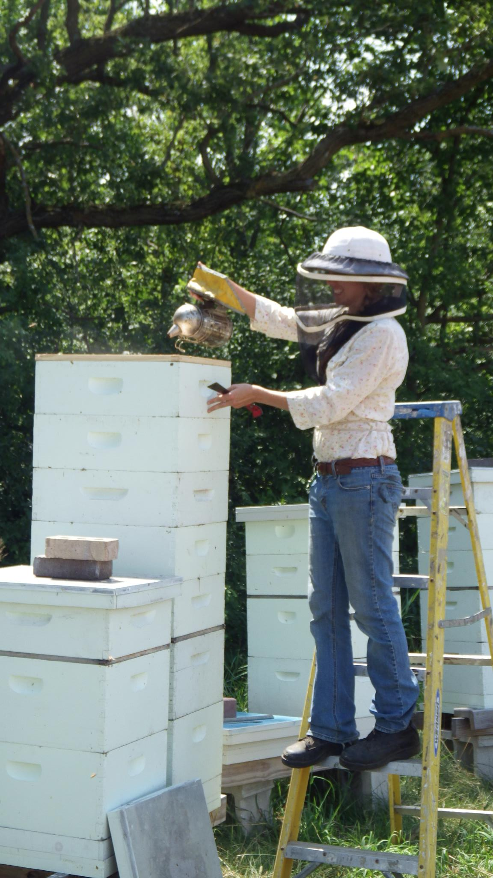
Sports Teams as Beekeepers

Slide 35
Externalities and Sports
Externality: an effect created by one individual or group whose effects are felt by others.
Can be positive or negative
What are some examples?

Slide 36
Externalities and Sports
Externality: an effect created by one individual or group whose effects are felt by others.
What are some solutions to the externality problem?

Slide 37
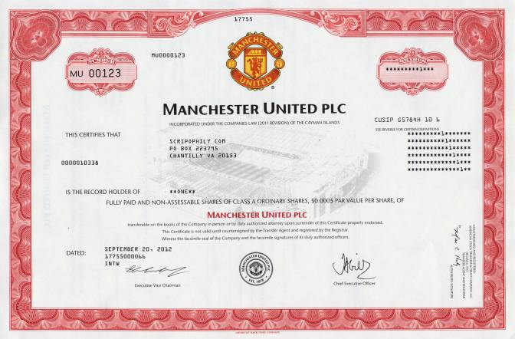
Externalities Solved
Joint ownership
Tax and subsidize (or just tax if the externality is negative)

Slide 38
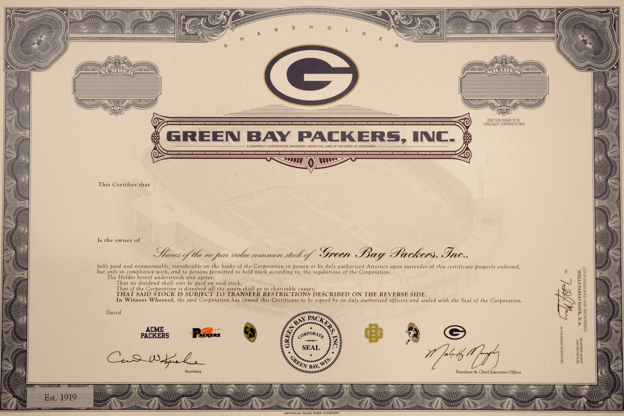
Ownership Information

Slide 39
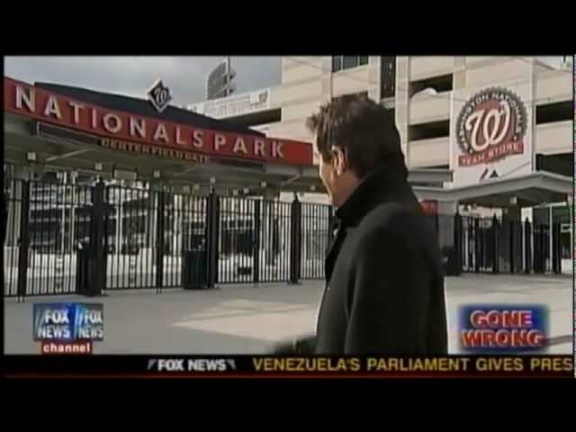
Analysis of ongoing stadium discussion:
FieldOfSchemes.com
https://youtu.be/ouQJJ4mP4hI
JC Bradbury discusses why stadium subsidies almost always win
(ReasonTV)
Sports Subsidy Costs & Costs

Slide 40
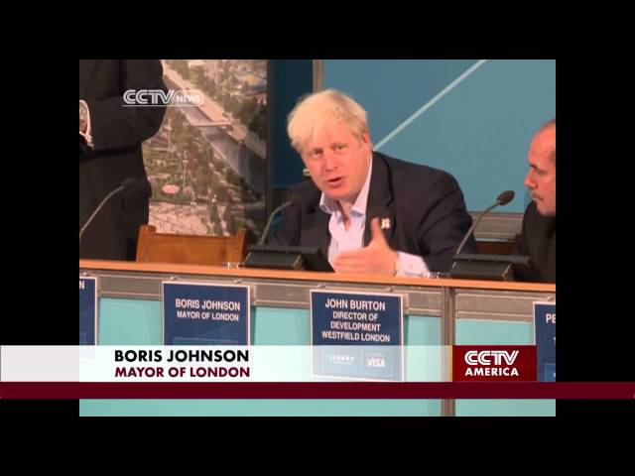
London’s Olympic Sized Budget
(link)
https://youtu.be/8HmWWZsSc0c
GDP growth before and after hosting the olympics
(link)
Economic Impact Studies

Slide 41

Subsidizing Owner Losses
Owners could actually lose money in some special circumstances despite their market power
What are there options if they are losing money?
Become a minor league team
Move

Slide 42
Subsidizing Owner Losses
How could they lose money?
Are accounting or economic profits below 0?
When should they be subsidized, then?
Where would the money come from?

Slide 43
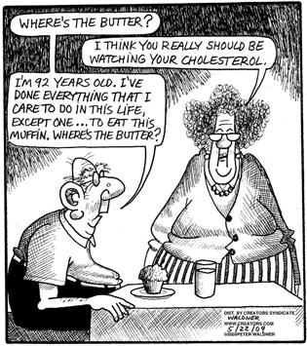
Cost-benefit Analysis in Sports

Slide 44
Cost-benefit Analysis in Sports
Sports subsidy costs come in three flavors:
Infrastructure Subsidies
Operating Subsidies
Stadium Construction Subsidies

Slide 45
Costs: Infrastructure Subsidies
Consist of payments made to reduce the costs of public services to the team’s facilities.
Water, electricity, roads/freeways, police, fire, and ambulance services.
These are common for many large businesses, not just sports (Costco).
Costco Subsidy Pocatello
Boeing & Largest State Subsidy Ever

Slide 46
Costs: Operating Subsidies
Consist of reductions in cost of leasing or using public spaces:
Few owners actually own the venue.
Might receive all revenue from ads in stadium, despite not being the owner.
Reduced property-tax rates.
Requirements to Host the Super Bowl

Slide 47
Costs: Stadium Construction Subsidies
When taxpayers fund the construction of new stadiums.
Political support from contractors, etc.
May tie team to city through long lease
Must be collected over time
Politically palatable
Cash payments demanded by others if given to team owners.

Slide 48
Benefits: Direct vs Indirect
Direct Economic Activity Benefits:
Happen in construction of stadium or in the stadium afterward
Indirect Economic Activity Benefits:
Happen in community surrounding stadium
Again, these are only benefits if they are creating benefits that would not have been realized otherwise. (Make sure we aren’t moving money from “left hand to the right”…)

Slide 49
Benefits: New Economic Activity
A firm wants to start up in the Pacific Northwest, and looks at Seattle and Portland.
Indifferent between the cities, but Seattle has 2 pro teams to Portland’s one, so firm goes to Seattle.
This would be New Economic Activity.
We can’t count businesses already in place as benefits of a professional team!

Slide 50
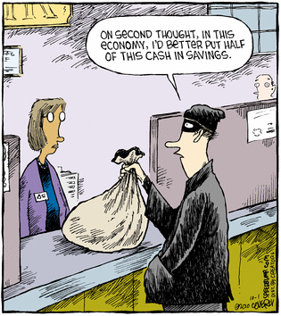
Benefits: New Economic Activity
Multipliers - How much does one dollar change the economy?
Changing the money multiplier from 1.9 to 2 on a $100M cash flow increases the benefit by $5.3M!

